Slide 1
Apache Cassandra ™
A distributed storage (Version 2.1.8)

Slide 2
Why Cassandra?
Is a distributed storage system for managing large amount of Structured data
Peer to Peer sets of nodes with no single point of failure
Replication across multiple data center is supported, failed nodes can be replaced with no downtime
Read and write throughput both increases linearly as new machines are added
No separate caching layer required
Tunable data consistency
Flexible schema design
No special hardware or software required
Cassandra Query Language (CQL) syntaxes alike SQL

Slide 3
NoSQL databases!
Cassandra
MongoDB
HBASE
Written in Java
Protocol: CQL and Thrift
Peer to peer sets of nodes (All nodes are similar) with no single point of failure
Map/reduce possible with Apache Hadoop using Spark
Colum Family storage, all data consists of an indexed key and value
Written in C++
Protocol: Custom, Binary-encoded serialization of JSON (BSON)
Master/slave replication
Custom Map/reduce, Group By clause used for aggregation. Prefer to define indexes, not map/reduce functions
Document storage, each document assign a unique index.
Written in Java
Protocol: HTTP/ REST (also Thrift)
Master/slave (called region servers) replication. Master that is responsible for coordination and RegionServer responsible for handling a subset of the table’s data
Map/reduce with Hadoop
Column store – (also known as wide-column stores) instead of storing data in rows, these databases are designed for storing data tables as sections of columns of data, rather than as rows of data.

Slide 4
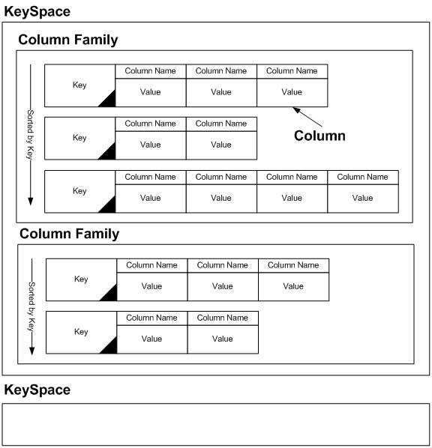
Cassandra – Data Model

Slide 5
Keyspace – A namespace for ColumnFamily (tables) in cluster
All data will resides in some keyspace
Main function is to control replication
Data with different replication requirement will be in different keyspace
Somewhat analogous to database in RDBMS.
CREATE KEYSPACE demodb WITH REPLICATION = { ‘class : ‘SimpleStrategy’, ‘replication_factor’: 3}
Replication factor- number of nodes in cluster that will receive the same data
Replication Strategy – strategy to place replica in the ring
SimpleStrategy
NetworkTopologyStrategy
ALTER KEYSPACE demodb WITH REPLICATION = {‘class’:’NetworkTopologyStrategy’, ‘dc1’ : 3,’dc2’ : 2}

Slide 6
Column Family – defines logical division that associates similar data
Defines columns and their metadata
Analogous to relational Table
Must specify a Primary Key
A table must restrict in a keyspace
Table data is distributed in the ring based on the partition key
CREATE TABLE user ( first_name VARCHAR, last_name VARCHAR,
display_name VARCAHR, PRIMARY KEY (first_name) );
ALTER TABLE user ADD email text;
DROP TABLE user;
Column
is the basic data structure of Cassandra with three values
Key or column name
Value
Time stamp
Column is a unit of storage
Row
is set of columns for each separate entries
It is unit of replication in Cassandra
Rows Key
Unique identification of each row
Name: byte[] | Value : byte[] | TimeStamp:byte[]

Slide 7
Cassandra Data Architecture
Memtable
In-memory data storage
Maintained for each Cassandra table
It stores sorted data by key and then written out sequentially
Stores writes until reaching a limit, and then it is flushed into SSTable
SSTable
A Sorted String Table is an immutable file
Storing data on disk
Maintained for each Cassandra table
SSTables are append only and stores data sequentially
Each SSTable has 3 separate files
Bloom Filter: a nondeterministic algorithm, testing if a key may be in a SSTable
Index
Data (key/ value string pairs, sorted by keys)
Commit Log
On disk storage
Used for Logging every data write (Insert, Update, Delete)
Providing configurable durability
it can be archived, deleted, or recycled

Slide 8
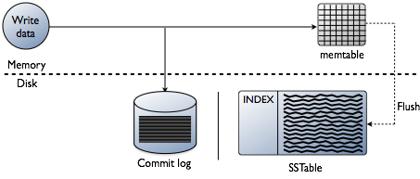
How write works in Cassandra?
Cassandra processes data at several stages on the write path
First write to Commit Log (Sequential)
After write to log it is sent to the appropriate nodes
Each node receiving write first records it in a local commit log,
Makes update to appropriate Memtables (one for each c* table)
Flushing data from the Memtable to respective SSTable when:
Memory full
Time duration (configurable)
When a commit log has had all its tables pushed to disk, it is deleted
Compaction: Data files accumulate over time. Periodically data files are merged sorted into a new SSTables
Merge Keys
Combine Columns
Discard Tombstones

Slide 9
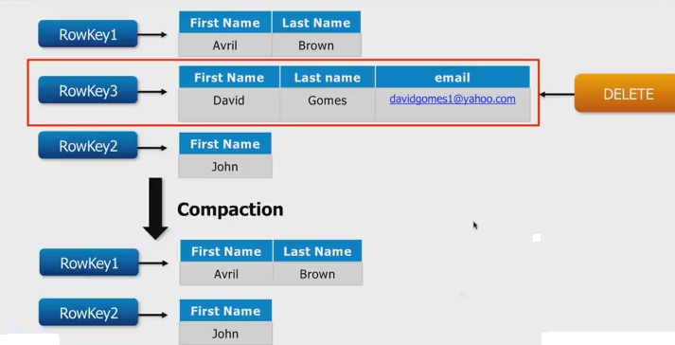
How delete works in Cassandra
The data is not immediately deleted
Deleted values are marked (Tombstone)
Column can have an optional expiration date called TTL (time to live)
When a CQL query deletes a value
A tombstone (delete marker) is applied to this column in its Memtable
Queries treats this column as deleted
At the next Memtable flush, the tombstone passes to new SSTable
At compaction, tombstoned column are evicted from the newly compacted SSTables

Slide 10
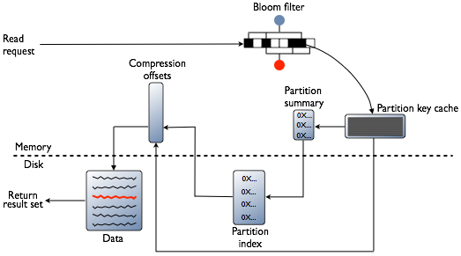
How read works in Cassandra?
To satisfy a read, Cassandra must combine results from the active memtable and potentially multiple SSTables
Cassandra checks the Bloom filter
Bloom Filter - a nondeterministic algorithm, testing if a key may be in a SSTable
checks the probability of having any data for the requested partition in the SSTable before doing any disk I/O
If the Bloom filter does not rule out the SSTable, C* checks the partition key cache
If an index entry is found in the cache:
C* goes to the compression offset map to find the compressed block having the data.
Fetches the compressed data on disk and returns the result set.
If an index entry is not found in the cache:
C* searches the partition summary to determine the approximate location on disk of the index entry
Next, to fetch the index entry, C* hits the disk for the first time, performing a single seek and a sequential read of columns (a range read) in the SSTable if the columns are contiguous
Cassandra goes to the compression offset map to find the compressed block having the data
Fetches the compressed data on disk and returns the result set

Slide 11
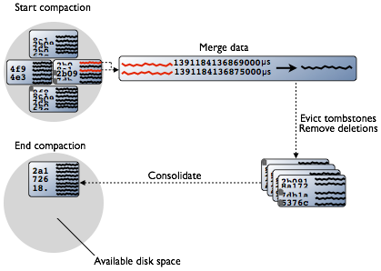
What is Compaction?
Insert and updates operations mutate Memtable partitions, but SSTables are immutable
No SSTable seek/overwrites
Memtables just accrue new timestamp insert/update
Insert/update flush to successive SSTable
SSTables must be periodically compacted
Related SSTables are merged
Most recent version of each column is compacted to one partition in one new SSTable
Column marked for deletion are evicted
Old SSTables are deleted

Slide 12
Transactions and concurrency control
Does not use RDBMS ACID transactions with rollback or locking mechanisms
Offers atomic, isolated, and durable transactions with eventual/tunable consistency
Atomic
Everything in a transaction succeeds or the entire transaction is rolled back
C* offers, a write is atomic at the partition-level
all operations in a Batch are performed atomically
Consistency
A transaction cannot leave the database in an inconsistent state
C* offers Eventual/ Tunable consistency: Availability and consistency can be tuned, and can be strong in the CAP sense--data is made consistent across all the nodes in a distributed database cluster
Isolation
Transactions cannot interfere with each other.
Read before write is not possible
Delete/ Batch operation are performed in isolation
Durability
Completed transactions persist in the event of crashes or server failure.

Slide 13
Data Consistency in Cassandra
C* extends the concept of eventual consistency by offering tunable consistency
Consistency Level
How many nodes must acknowledge a read/ write request
Consistency level may vary for each request
On success coordinator notify client (with data if read request)
Write consistency level
determines the number of replicas that need to acknowledge the write success
Read consistency level
specifies how many replicas must respond to a read request before returning data
Possible Consistency Level
ANY
ONE
QUORUM (RF/2)+1
ALL
REQ
N1
ACK
N4
REQ
N2
REQ
ACK
ACK
Data
N3
REQ
Client
CL=QUORUM

Slide 14
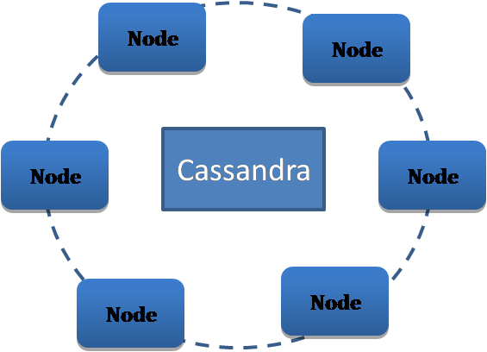
Cassandra Cluster Architecture
Designed with the understanding that system/HW failure can do occur
Cassandra has Ring based replication (No Master/ Slave), all nodes are same
Peer to peer distributed system
Data partitioned among all noes in the cluster
Each node exchanges information across the cluster every second
Custom data replication to ensure fault tolerance
Read/ Write can possible at any node
Key Structure of C*
Node – Data storage location ( an instance of Cassandra)
Partition – one unit of data on a node
Rack – a logical sets of nodes
Data Center – a logical set of Racks
Cluster – a full set of nodes which maps to a single complete token ring
Commit Log – Crash-recovery mechanism, every write operation is written to the commit log
C* Cluster
Cassandra Cluster
Data Center -1
Data Center -2
Rack 1
Rack 2
Rack 2
Rack 1
Node1
Node5
Node6
Node2
Node3
Node7
Node8
Node4

Slide 15
Key components for configuring Cassandra
Gossip: A peer to peer communication protocol to discover and share state information abut the other noes in a cluster
Process runs every second, exchanges state messages with up to three other nodes in the cluster
Persisted locally by each node
Same list of seed nodes for all nodes in a cluster
The seed node designation has no purpose other than bootstrap
Partitioner: determines how to distribute the data across the nodes in the cluster and which first node to replicate the data
Each row of data uniquely identified by a partition key
Murmer3Partitioner is the default portioning strategy
Replication Factor: Total number of replicas across the cluster
Should be greater than one
Must not exceed the number of nodes in the cluster
Replication Strategy: determines which nodes to place replicas on
SimpleStrategy
Used for single data center
Places the first replica on a node determined by the partitioner
Additional replicas are placed on the next nodes clockwise in the
NetworkTopologyStrategy
Deployed across multiple data centers
This strategy specify how many replicas you want in each data center
Snitch: defines groups of machines into data centers and racks, that the replication strategy uses to place replicas
SimpleSnitch (default) used for single-data center deployment
GossipingPropertyFileSnitch is recommended for production

Slide 16
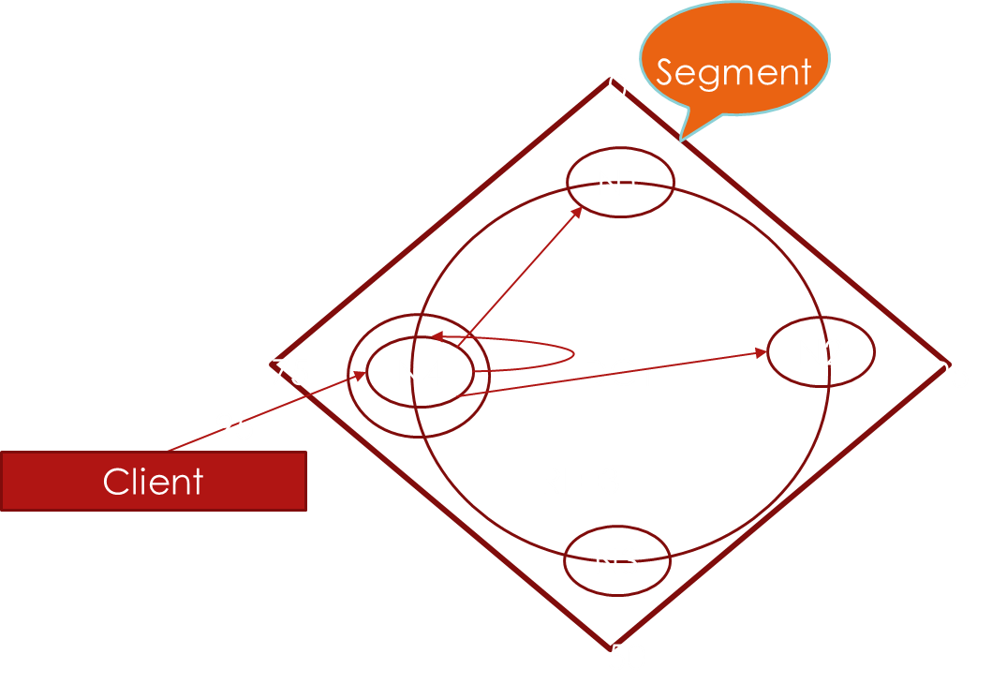
Data distribution and replication
In Cassandra, data distribution and replication go together
Data is stored on nodes in partitions, each identified by a token
Token: a 128 bit integer is used to identify each partition and node
Partition: a unit of data storage on a node (analogous to row)
Partition Key: a token calculated to identify a specific partition
The 2¹²⁷-1 value token range for a cluster as a ring
Partition key determines the first node where replica placed on
Additional replica place determined by other factors
Replication Factor
Replication Strategy
Segment are possible range of partition key
In each segment, a minimum and one maximum range of token exists

